Slide 1
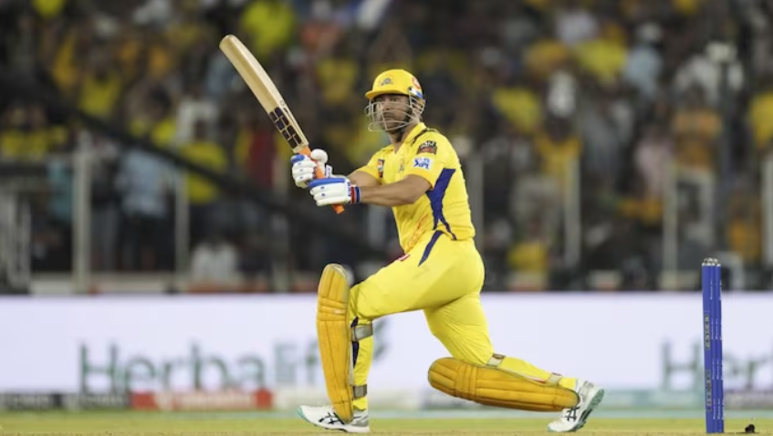
IS MS DHONI STILL GOOD ENOUGH TO BAT??

Slide 2
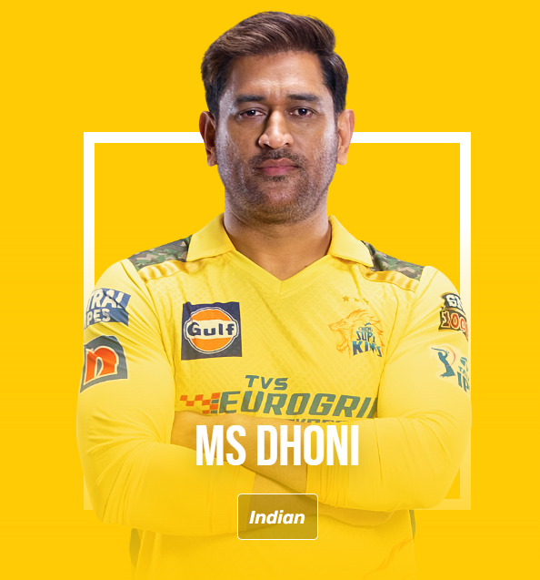
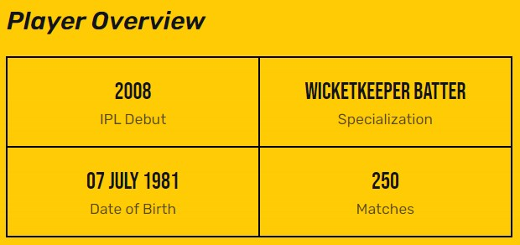
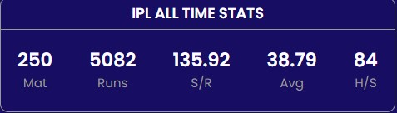
STATS OF MSD

Slide 3
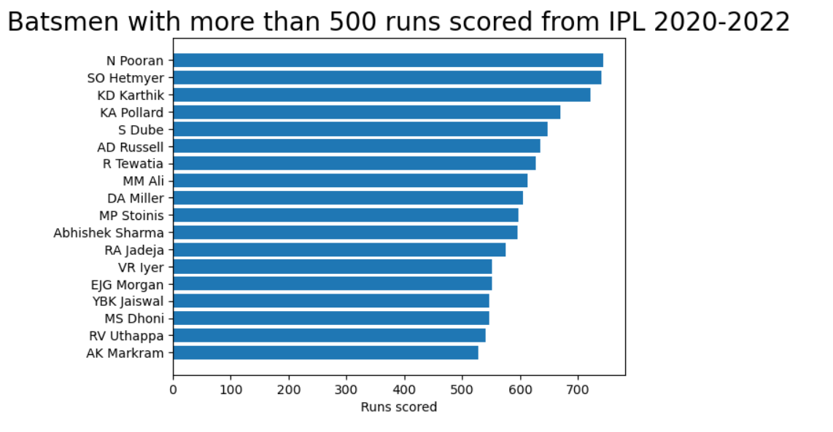
COMPARISION OF PERFORMANCE ANALYSIS WITH OTHER PLAYERS FROM IPL (2020-22).

Slide 4
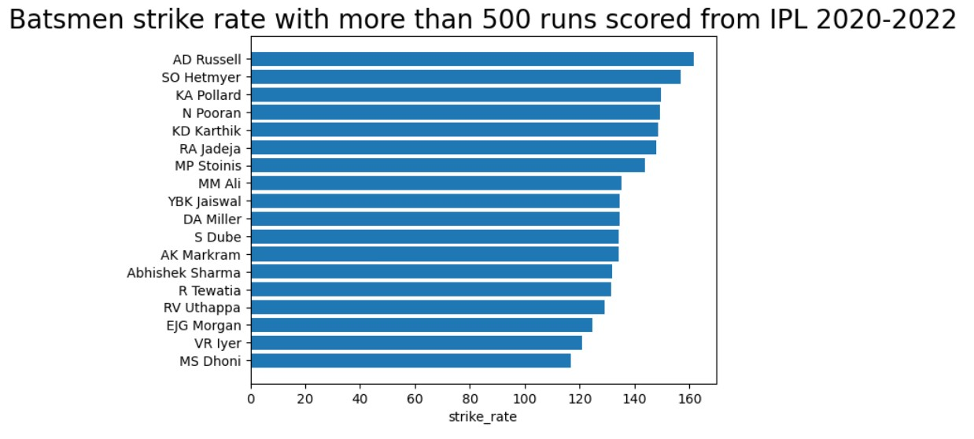
COMPARISION OF PERFORMANCE ANALYSIS WITH OTHER PLAYERS FROM IPL (2020-22).

Slide 5
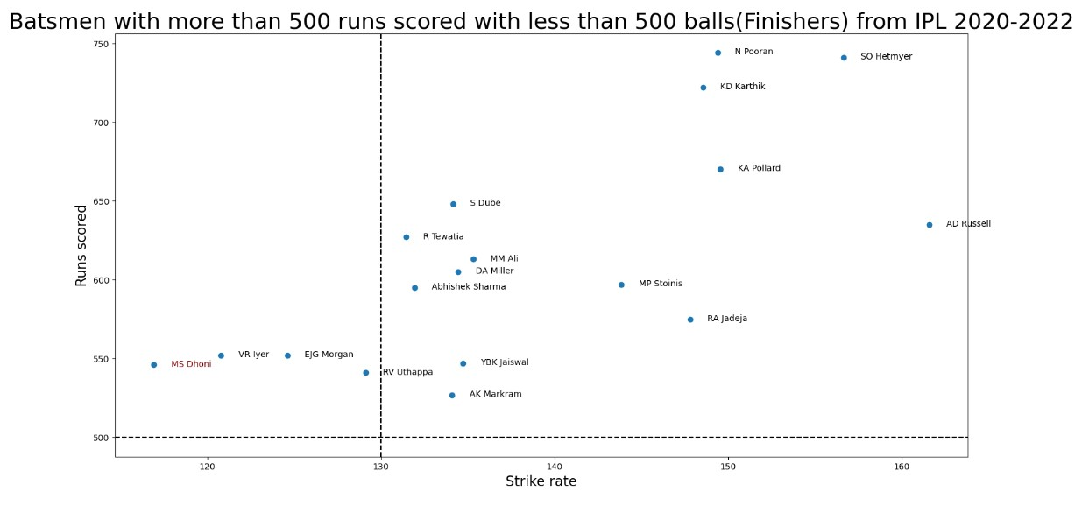
COMPARISION OF PERFORMANCE ANALYSIS WITH OTHER PLAYERS FROM IPL (2020-22).

Slide 6
Comparision between other finishers of TATA IPL 2023
PLAYERS | RUNS | BALLS | INNINGS | STRIKE RATE | AVERAGE_RUNS | AVERAGE_BALLS
Dhoni | 104 | 57 | 12 | 182.00 | 8.666667 | 4.750000
Pooran | 358 | 207 | 15 | 172.94 | 23.866667 | 13.800000
Miller | 259 | 178 | 13 | 145.50 | 19.923077 | 13.692308

Slide 7
REPORT
IS DHONI STILL GOOD ENOUGH TO BAT?
Report of MSD Analysis
1.The past three years of dhoni’s data (IPL 2020-2022) shows that MSD can score some good amount of runs, but only with a below strike rate of 120 and thus showing that he can survive by only scoring ball to ball runs.
2.When it comes to this year’s data (IPL 2023) of comparison with pooran and miller, it shows that he had came back better than before by scoring with a better strike of average ball of 4.75 and scoring an average of 8.6 runs with a strike rate of 182.46 which is better than pooran and miller.
3.It summarizes that MSD is still good enough to bat in TATA IPL with an optimum strike rate by much better than before in between (IPL 2020-2022).

